Slide 1



Towards Cloud-Native RAN for 6G NTN-Based
Connectivity in Aviation
Presenter: Babak Mafakheri

Slide 2




Scenarios under study
Regenerative payload with WiFi access onboard aircraft
Transparent payload with 5G access onboard aircraft
5G gNB (RU+DU)
Transparent Payload
5G/NTN UE
WiFi UE
WiFi
WiFi AP
5G UE
5G link
gNB (RU+DU)
Babak Mafakheri
(Babak.Mafakheri@zii.aero)

Slide 3
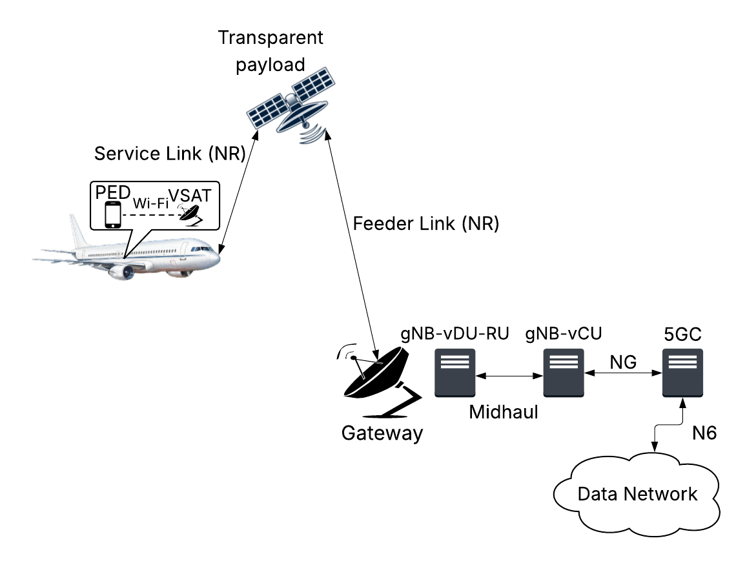
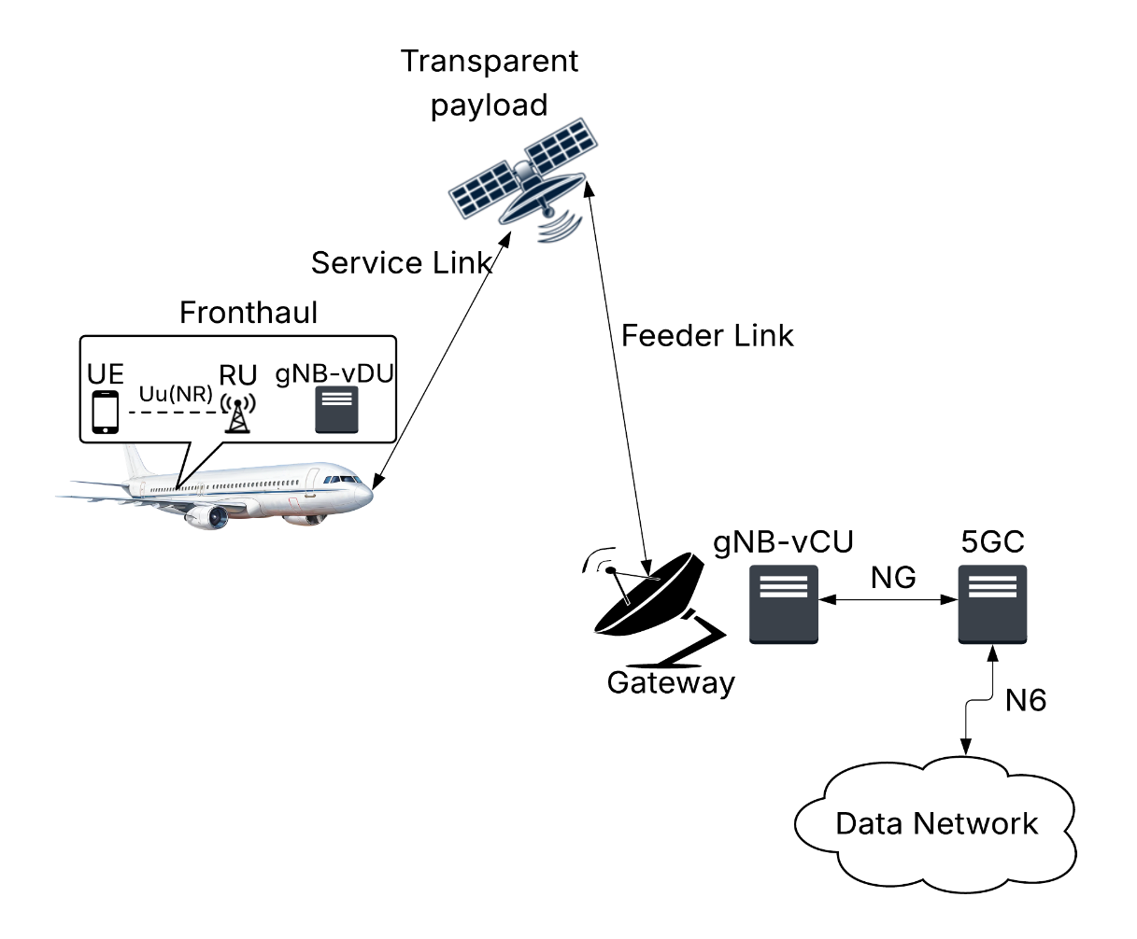
Transparent Payloads
Transparent payload, all
vCU/vDU/RU on ground
Transparent payload, vCU on
ground; vDU+RU on aircraft
A
B
Babak Mafakheri
(Babak.Mafakheri@zii.aero)

Slide 4
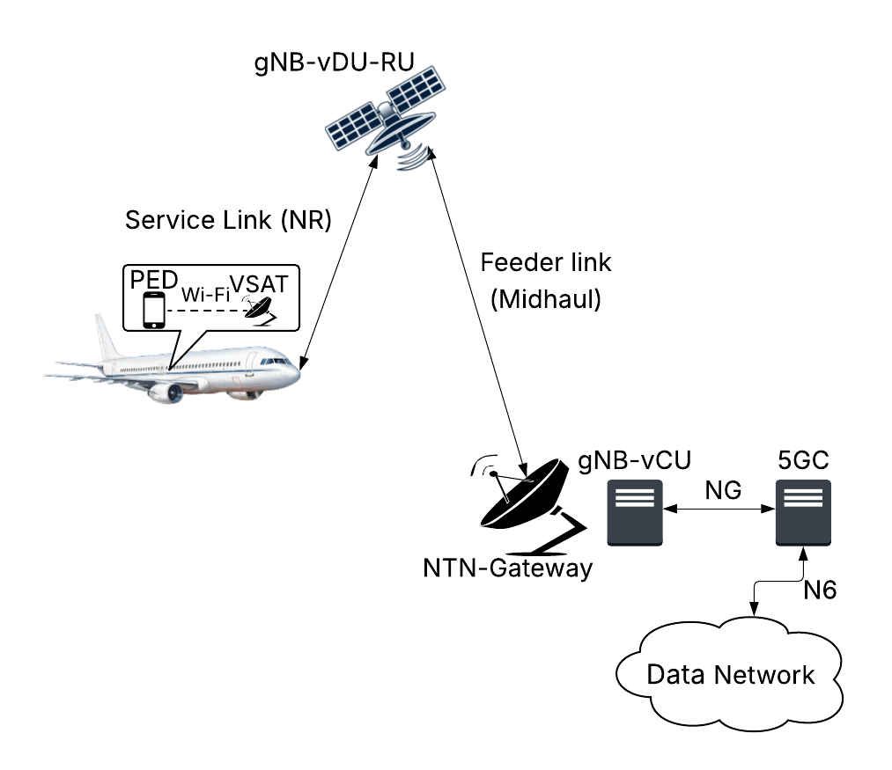
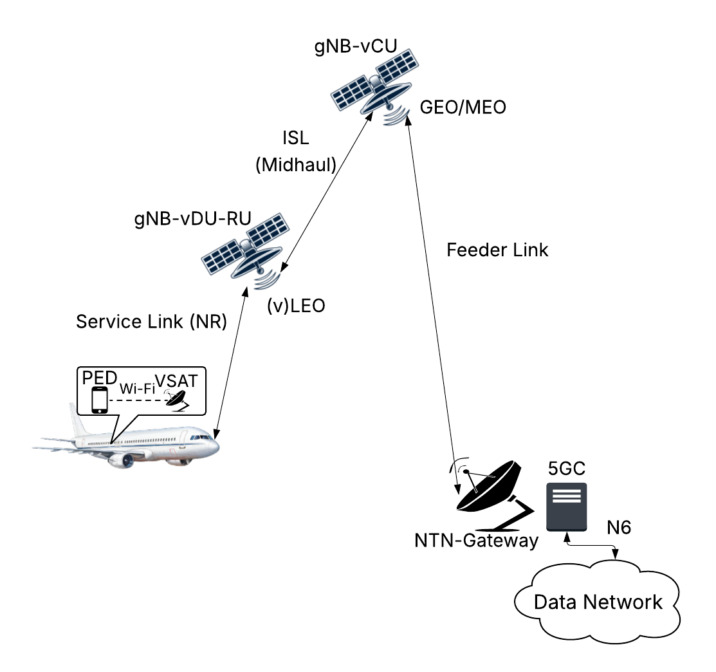
Regenerative Payloads
Regenerative payload, vCU on
ground; vDU+RU on LEO
Regenerative payload, vCU on
GEO/MEO; vDU+RU on LEO
C
D
Babak Mafakheri
(Babak.Mafakheri@zii.aero)

Slide 5
HARQ Challenges in NTN
Long Round-Trip Time (RTT):
  GEO: ~500–600 ms, MEO: ~120–250 ms, LEO: ~20–50 ms — much longer than typical terrestrial HARQ timing (~8–10 ms).
  This causes feedback delays that break conventional HARQ timing structures in LTE/5G.
ACK/NACK Timing Misalignment:
  The feedback from the receiver may arrive too late for standard HARQ processes, leading to buffer overflows or process starvation.
Limited HARQ Process Parallelization:
  Increasing the number of parallel HARQ processes can partially compensate for the delay, but UE and gNB memory limitations make this impractical, especially for handheld or airborne terminals.
Transparent or Regenerative Payloads:
  In transparent payloads, HARQ feedback must traverse the satellite twice (uplink + downlink), worsening delay.
  Regenerative payloads could reduce latency but require onboard HARQ functionality and buffer management.
Babak Mafakheri
(Babak.Mafakheri@zii.aero)

Slide 6
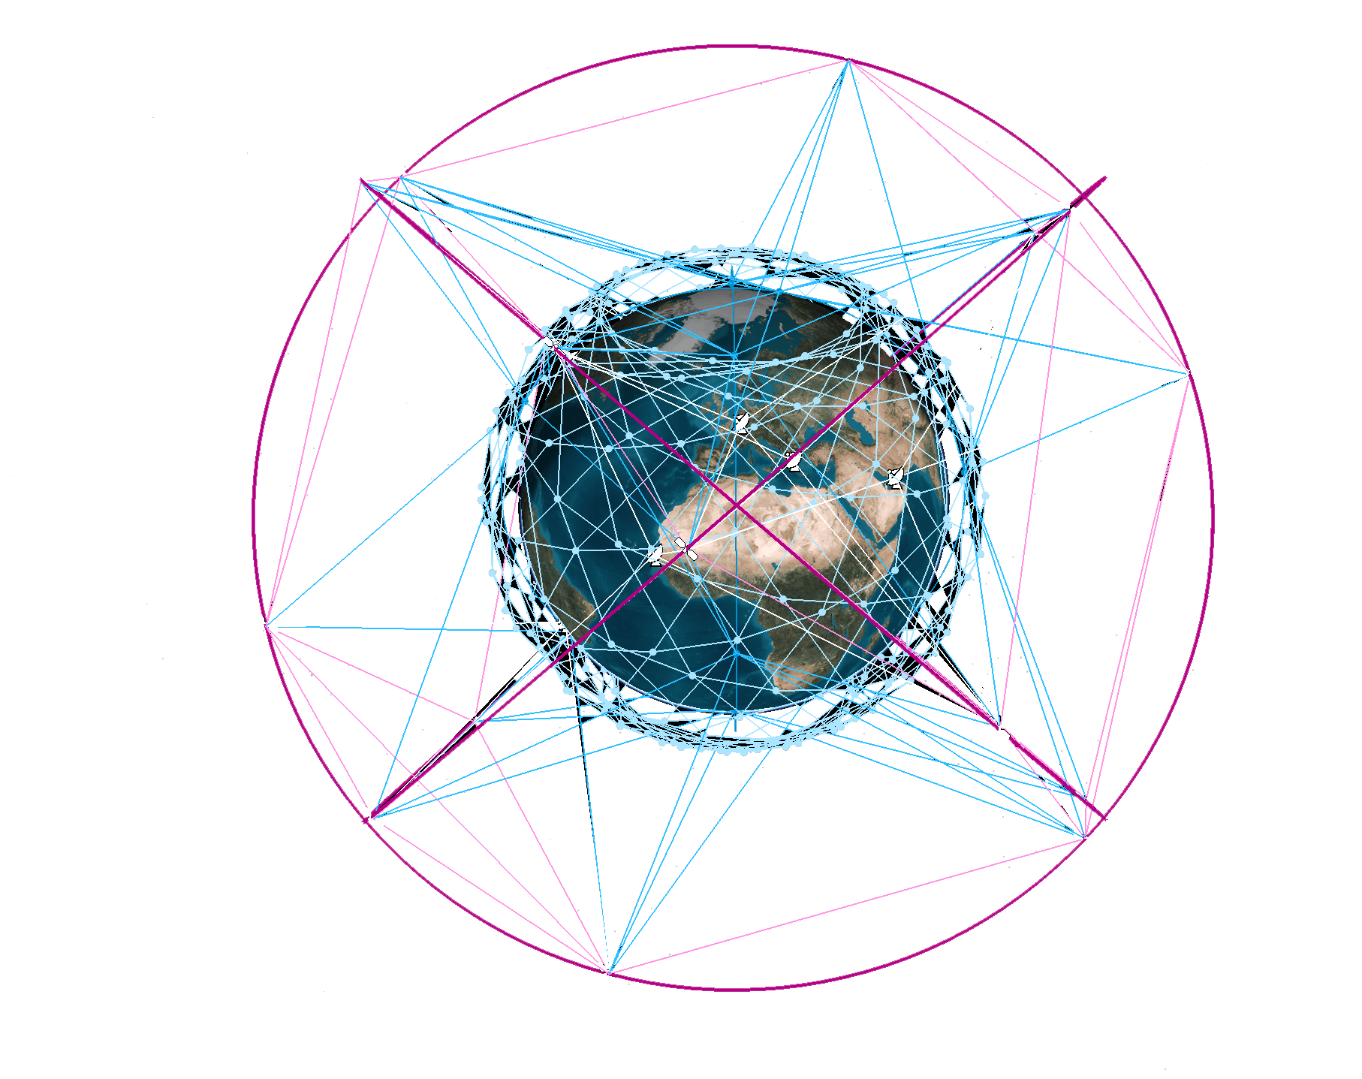
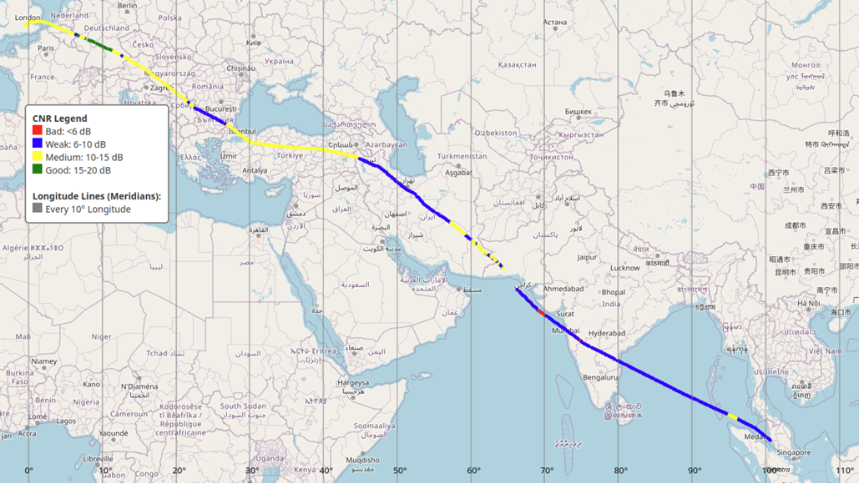
Simulation Environment
Satellite constellation followed the IRIS2 initiative
  264 LEO (1200 km) – EIRP: 56 dBm
  18 MEO (8800 km) – EIRP: 70 dBm
  Frequency (Ku bands)
Real flight trajectory data
  Long-haul Singapore - London
  Latitude, Longitude, Heading
  Roll & Pitch angles
  ESA Antenna: # elements: 1024, gain: 5dBi, scan degree: 60
Source: Satellite Connectivity Prediction for Fast-Moving Platforms
Chao Yan, Babak Mafakheri
Source: https://www.spacerise.eu/
Babak Mafakheri
(Babak.Mafakheri@zii.aero)

Slide 7
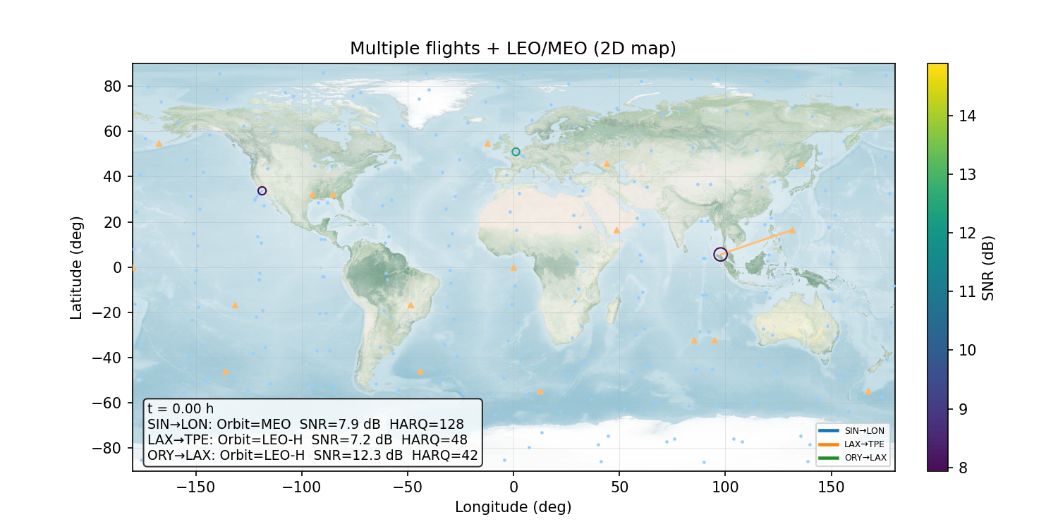
Simulated Scenario
Babak Mafakheri
(Babak.Mafakheri@zii.aero)

Slide 8
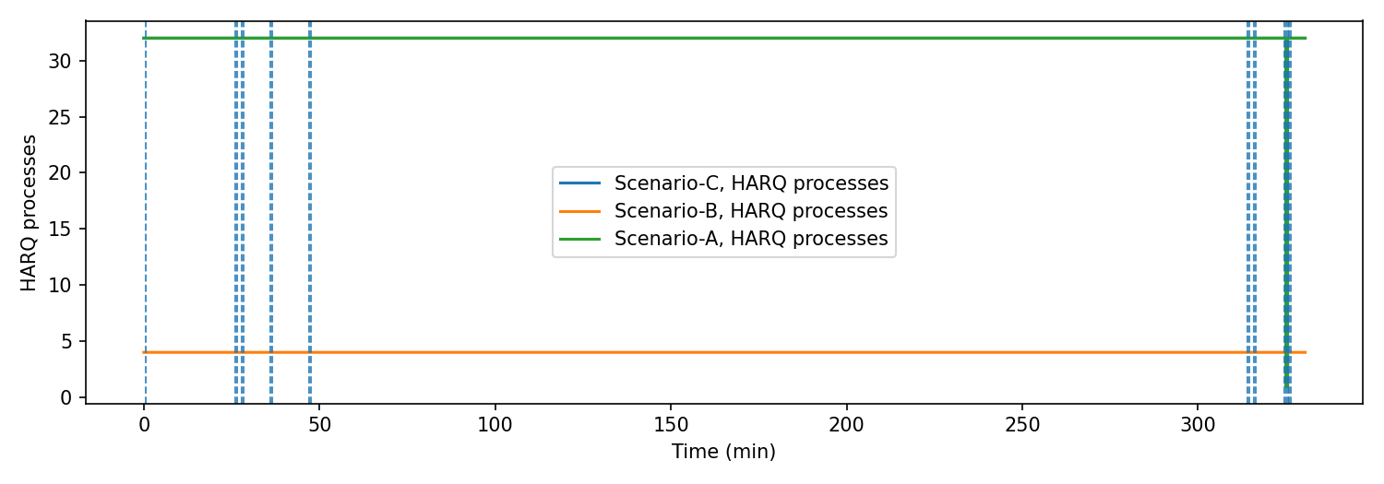
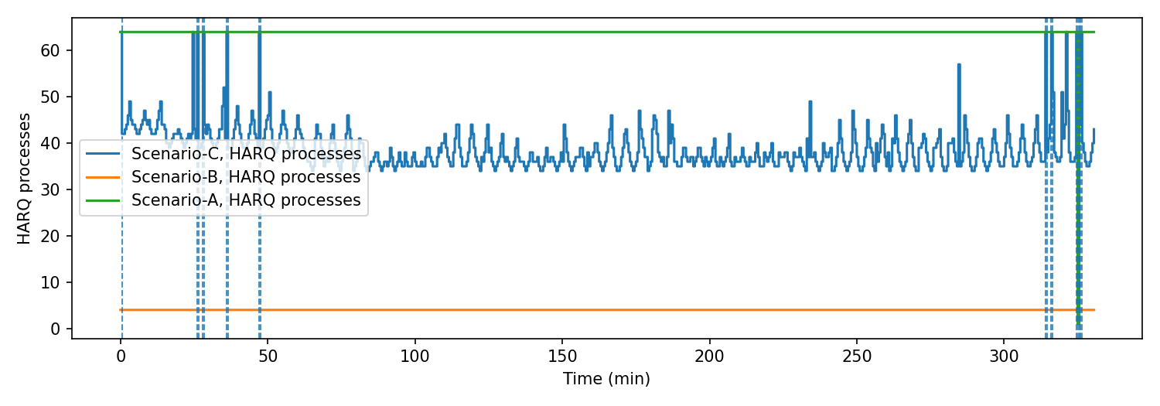
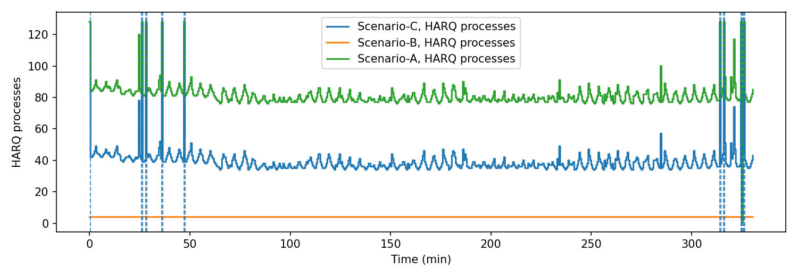









Simulated Results - HARQ
A
RTT $={2.T}_{one−way}+T_{Proc}$
$$N_{cap} = 32$$
$$T_{one−way}= \frac{d}{c}$$
$$N_{proc,req}=[\frac{RTT}{T_{slot}}]$$
B
$$N_{cap} = 64$$
$$T_{slot} = \frac{1}{2^{μ}}$$
$$μ=\log_{2}(\frac{SCS}{15 KHz})$$
$N_{proc}={min(N}_{proc,req}+N_{cap})$
C
$$N_{cap} = 128$$
Babak Mafakheri
(Babak.Mafakheri@zii.aero)

Slide 9
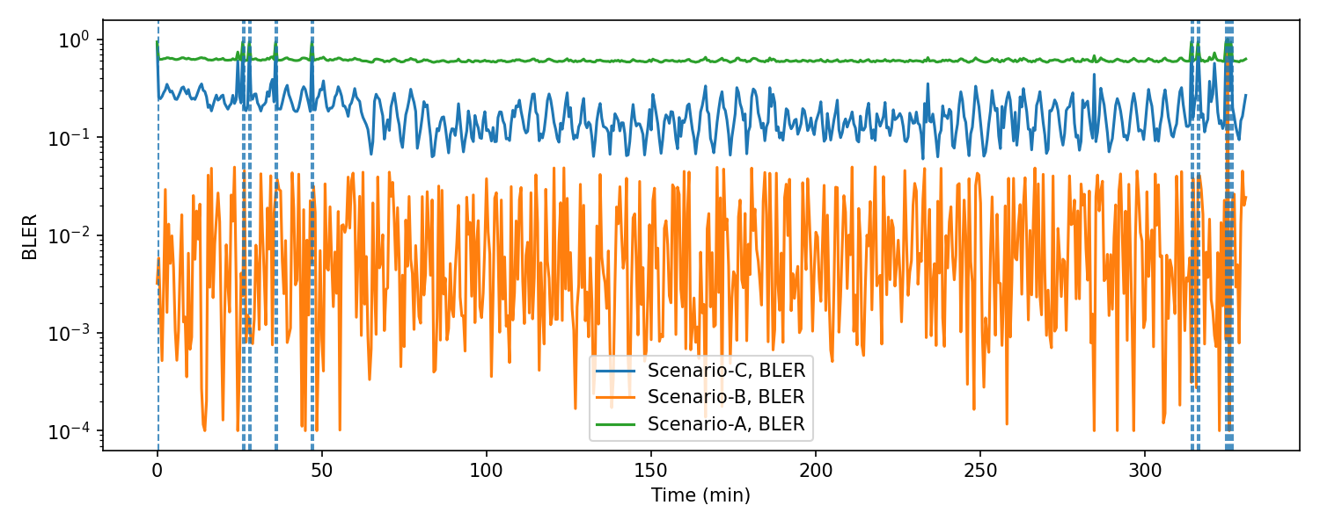
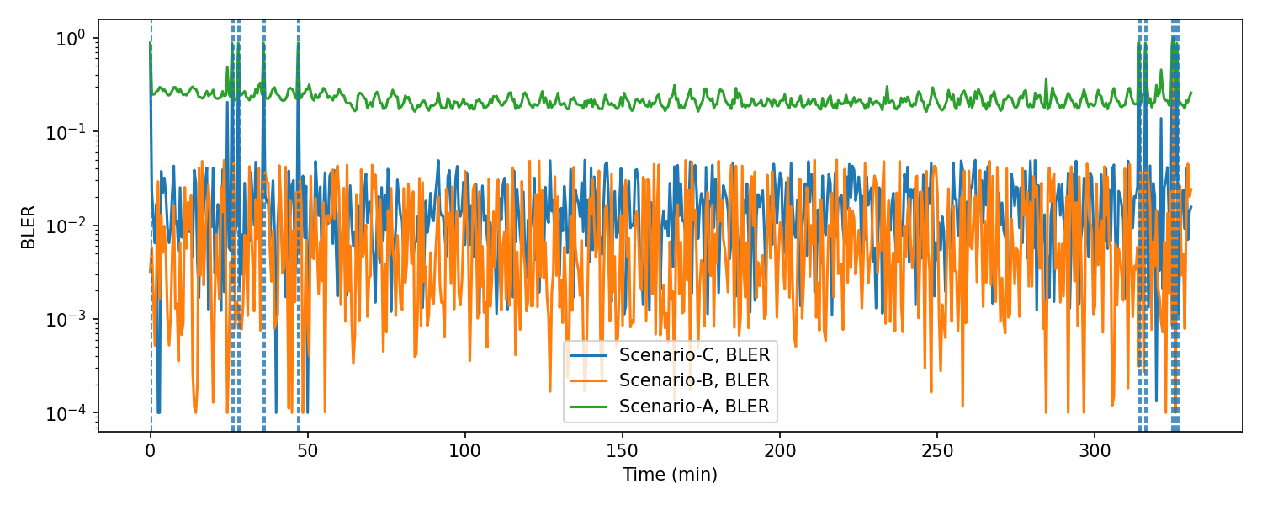
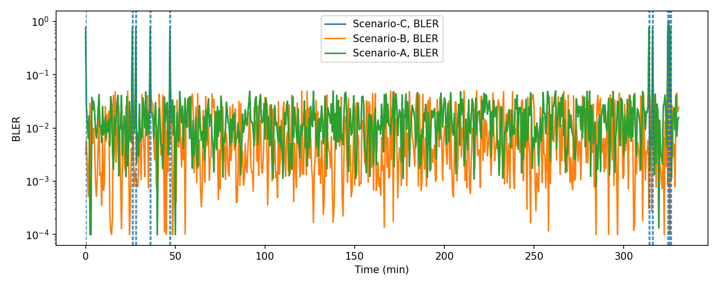
Simulated Results - BLER
A
$$N_{cap} = 32$$
B
$$N_{cap} = 64$$
C
$$N_{cap} = 128$$
Babak Mafakheri
(Babak.Mafakheri@zii.aero)

Slide 10
Simulated Results – Comparison
Babak Mafakheri
(Babak.Mafakheri@zii.aero)

Slide 11
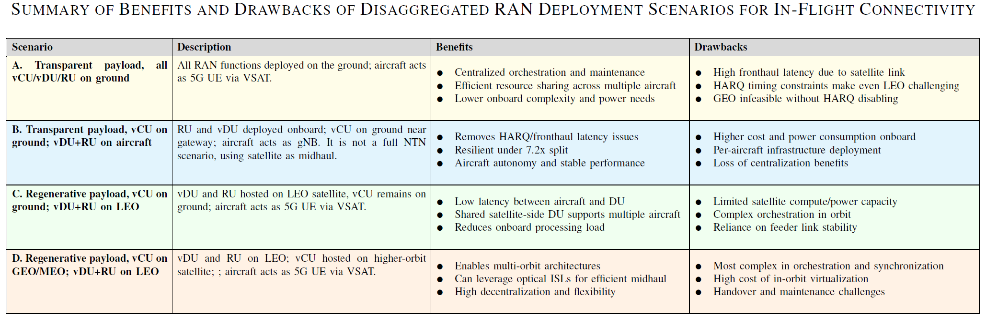
Summary
Babak Mafakheri
(Babak.Mafakheri@zii.aero)

Slide 12
Challenges Key Takeaways
  Cloud-native dRAN enables flexible DU placement across TN/NTN nodes
  Traditional fixed RANs struggle under high-mobility (aviation) scenarios due to HARQ timing limits.
  DU on satellite: Large RTT → limited HARQ processes → higher BLER, lower throughput
  DU onboard aircraft: Eliminates HARQ bottleneck → better reliability and throughput.
  Dynamic DU instantiation via containerization & orchestration
  Adapt deployment based on latency and link conditions.
  LEO (low latency): DU can stay on satellite → lower onboard power use
  MEO/GEO (high latency): DU can move onboard → mitigates HARQ starvation.
Conclusions
Benefits:
  Optimized energy, throughput, and error rate.
  Seamless switch between transparent & regenerative modes.
  Fully aligned with 6G goals: resiliency, efficiency, sustainability.
Babak Mafakheri
(Babak.Mafakheri@zii.aero)

Slide 13
Babak.Mafakheri@zii.aero

